Slide 1
Ed-Tech Business Intelligence
Presented by :
Pratikesh Sampale

Slide 2
Aim
To understand the concepts of business intelligence insights, by analysing various successful conversions.
Data cleaning and EDA through python and identifying the KBRs and KPIs for this specific business problem.

Slide 3
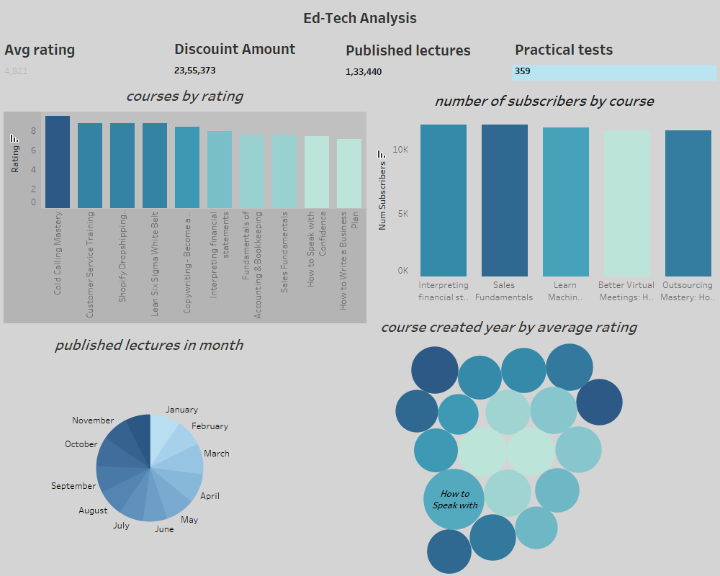
Tableau dashboard

Slide 4
Thank you

